Slide 1



Problem Solving Through Algorithms
She and They Do Science and Tech

Slide 2
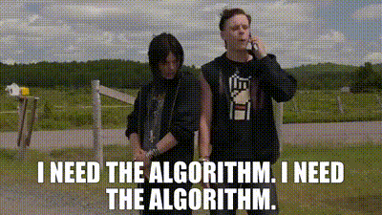
What is an algorithm?

Slide 3
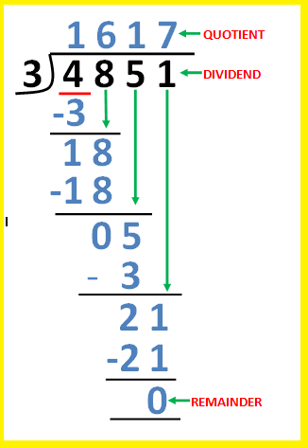
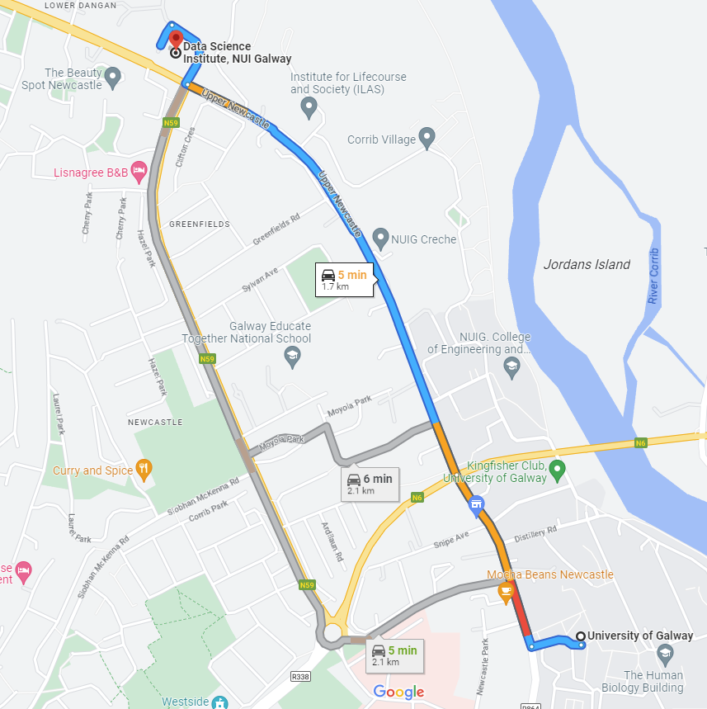
What is an algorithm?
A series of steps or instructions for solving a problem or achieving a desired result.
Examples:
Map directions
Long division
Recipes
Notes:
Before I learned about what algorithms are, I found the idea very intimidating. Sometimes movies or shows will talk about “the algorithm” as some big, complex, scary entity, sometimes bent on world domination or something. But they don’t have to be complex!
A recipe you follow when cooking or baking (ingredients are your inputs!)
The directions you followed to get to DSI today (whether walked or drove)
Long division or other arithmetic (“carry the 1”)

Slide 4

Recipe = Algorithm
How is a recipe an algorithm?
Desired Outputs: Delicious cupcakes
Required Inputs: Ingredients, supplies
Instructions to turn the Inputs into the Outputs:
Notes:
A recipe you follow when cooking or baking (ingredients are your inputs!)

Slide 5
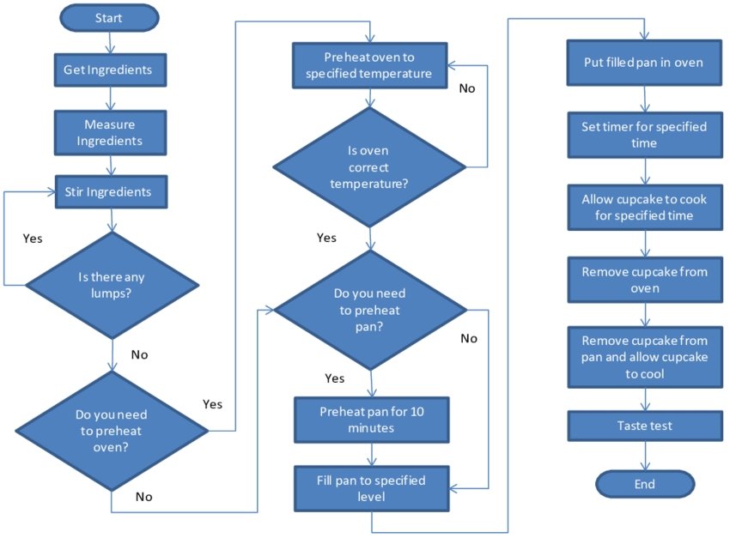
Recipe = Algorithm
(Joiner and Brewster 2017)
Notes:
A recipe you follow when cooking or baking (ingredients are your inputs!)

Slide 6
How to use algorithms
How can algorithms help us with our problem-solving?
Lots of problems require several steps in order to be solved, and often require flexibility in the steps depending on different starting conditions.
We’ll start with a simple exercise about evaluating the lengths of words.

Slide 7
Exercise!
We want to write a very simple algorithm where, given a word and an integer, it tells us whether the length of the word is greater than, less than, or exactly the value of the integer. (Note– we already have a function that will tell us the length of a word!)
For example:
Given “hello” and 3, we would get that “hello” is longer than 3.
Given “perceptive” and 10, we would get that “perceptive” is exactly 10 letters long.
Notes:
Long division or other arithmetic (“carry the 1”)

Slide 8
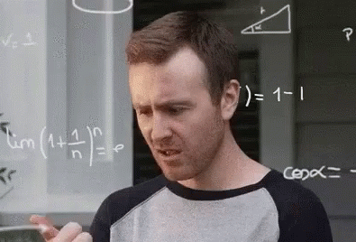
Exercise!
Inputs: word, integer
Pseudocode:
get length of word
check word length against reference integer
print the relationship between them
len(word)
Have to check one condition at a time (greater, less, equal)
print(word, “is…”)
Notes:
Long division or other arithmetic (“carry the 1”)

Slide 9
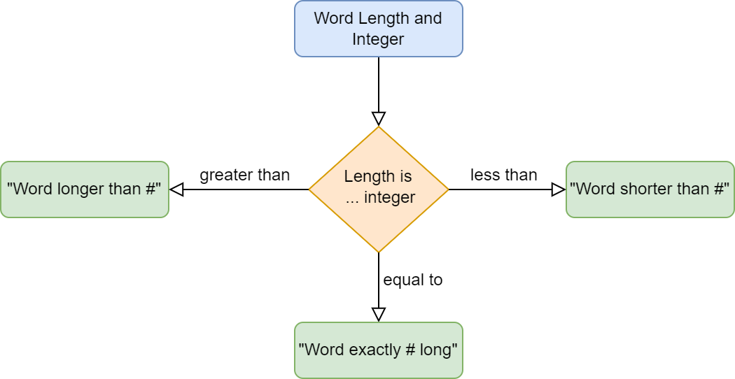
Exercise!
Conditions
Notes:
Long division or other arithmetic (“carry the 1”)

Slide 10
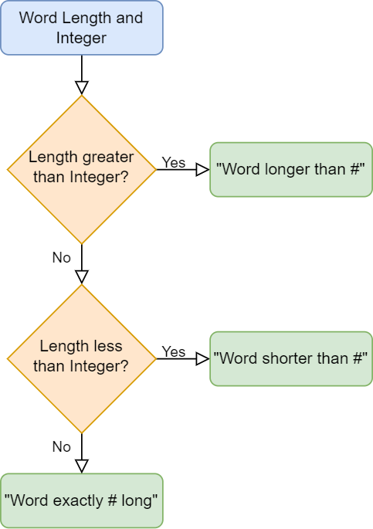
Exercise!
Conditions
Notes:
Long division or other arithmetic (“carry the 1”)

Slide 11
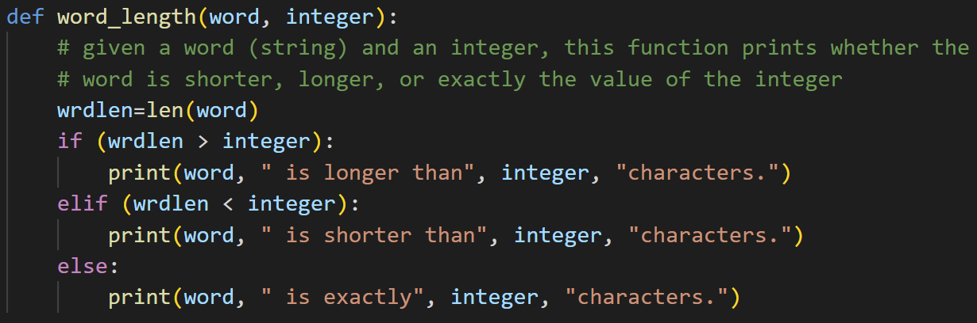
Exercise!
There are other ways you could write the algorithm and get the same output!
For example, you could have…
Used elif (wrdlen == integer): in place of the last else:
You could have checked the greater than/ less than/ equal to in any other order
You could have created a variable called something like relationship to store the result of your if statement, then printed your results later.
Some ways may be more “efficient” than others, but when you’re just trying to solve a problem, you can make your algorithm as simple or complex as you want!
Notes:
Long division or other arithmetic (“carry the 1”)

Slide 12

Another exercise!
Example: 28
3- me
4- ow
6- me
8- ow
9- me
12- meow
15- me
16- ow
18- me
20- ow
21- me
24- meow
27- me
28- ow
Slightly more complicated example: me-ow
Given an integer, we want to list all numbers leading up to and including that integer, printing “me” if the number is a multiple of 3, “ow” if the number is a multiple of 4, and “meow” if the number is a multiple of both 3 and 4.
Notes:
Long division or other arithmetic (“carry the 1”)

Slide 13
Another exercise!
Pseudocode:
Get number/ prompt for input
For loop iterating through range leading up to number
For each number, check if multiple of 3 or 4
If multiple of 3, print number and “me”
If multiple of 4, print number and “ow”
If multiple of both, print number and “meow”
Hints:
The remainder operator is %
Notes:
Long division or other arithmetic (“carry the 1”)

Slide 14
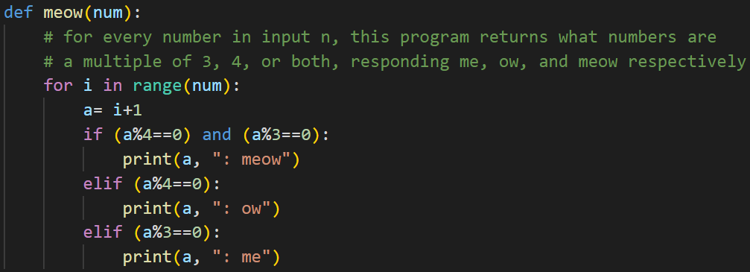
Another exercise!
Again, this is just one possible solution!
Notes:
Long division or other arithmetic (“carry the 1”)

Slide 15
Guessing Game
We want to write two guessing games using algorithms.
In the first, the computer will pick a number and we will try to guess it.
In the second, we will pick the number and the computer will have to try to guess it.
Both games will require a loop, the random library, and user input.
Now let’s talk about the details of our first game.
Notes:
Long division or other arithmetic (“carry the 1”)

Slide 16

Guessing Game
Requirements:
To input the range of numbers to guess from
The computer to generate a number for us to guess
To input our guesses until we reach the right one
To keep track of how many guesses it takes us to get it right
Harrison et al (2015)
Notes:
Long division or other arithmetic (“carry the 1”)

Slide 17
Guessing Game
Pseudocode:
[Prompt to] input upper bound
Generate random number
Initialize loop control variable
Initialize count variable
Begin loop
Input guess
Check if guess higher/ lower/ correct
Print whether higher/ lower
Update count variable
When correct, exit loop via loop control variable
Print congratulations and how many guesses it took

Slide 18
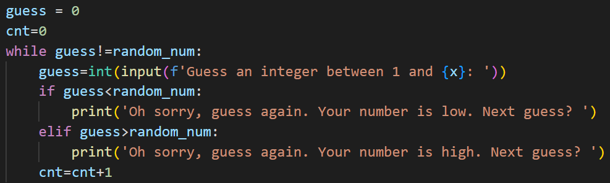
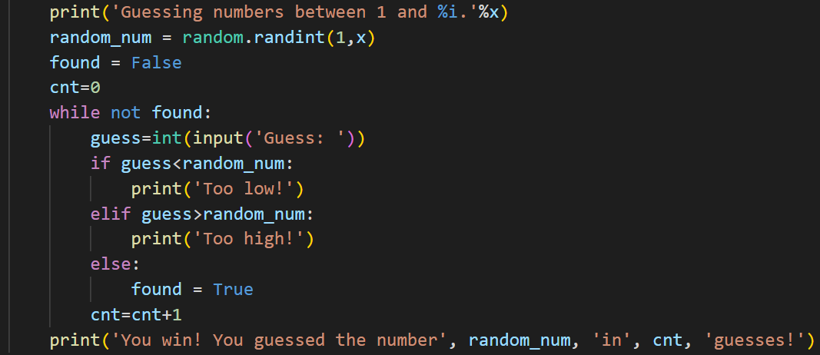
Guessing Game
Possible solutions!
Notes:
Long division or other arithmetic (“carry the 1”)

Slide 19
References
Chawla, Rakhi. (2018). Hacking Long Division Algorithm. Medium. url: https://medium.com/@rakhichawlaEd3D/lets-t-i-n-k-e-r-division-blog-series-2-hacking-long-division-algorithm-ae1ef5fc568b
Joiner, Keith & Brewster, Amy. (2017). Cooking Perfect Cupcakes: Freeing Curricula Context Gives Student-Centred Pedagogy for Course on Experimental Design. Creative Education. 08. 1833-1859. 10.4236/ce.2017.812126.
Harrison, Holly, Evan Palmer, Charles McGregor, and Andy Leigh. (2015). Meet Evva. Pollen Midwest. url: https://www.pollenmidwest.org/stories/meet-evva/
Notes:
Long division or other arithmetic (“carry the 1”)

